Slide 1
LI/SC – ??/2/24
Learning Intentions
Success Criteria
Examine the site and situation of SW of W.A. and Wheatbelt. Examine SPICESS in relation to the environmental change taking place in SW of W.A. and Wheatbelt.
For each part of SPICESS, outline what each means using SW of W.A. and Wheatbelt environmental change. Outline causes and likely consequences of the environmental change.

Slide 2
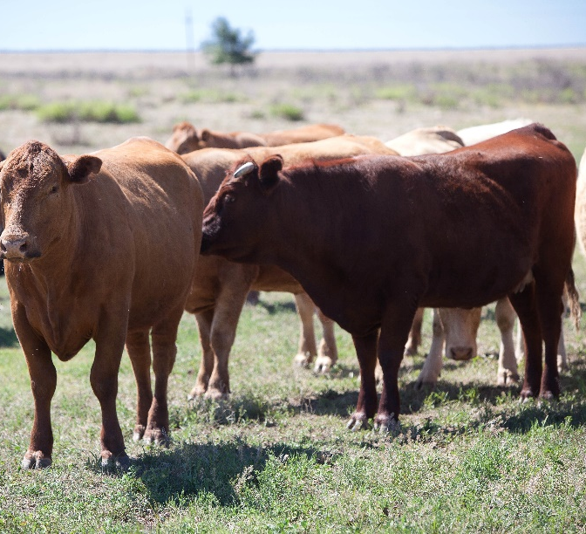
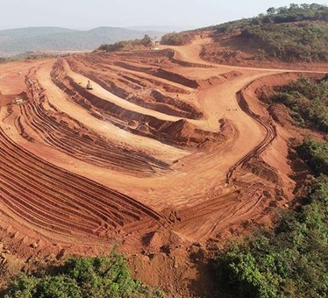
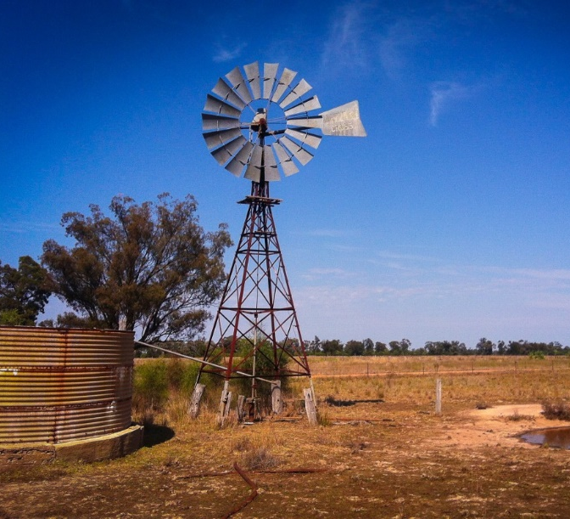
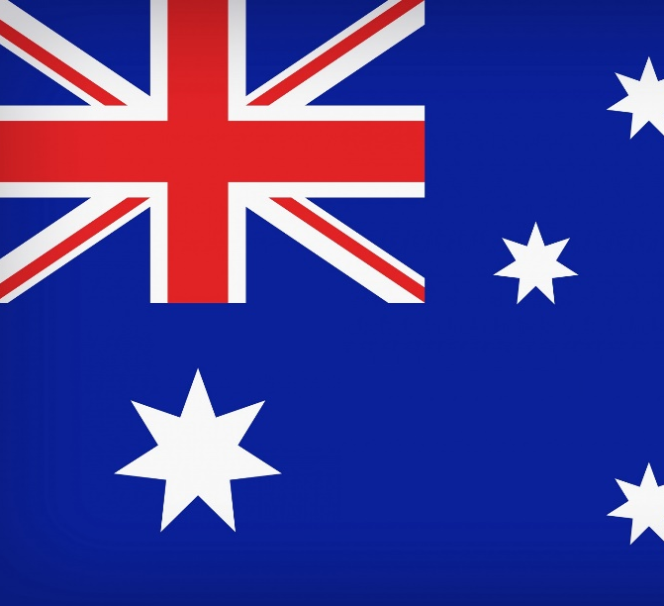
Year 10 Geography Comparative Case Study LAND
Country: Australia

Slide 3
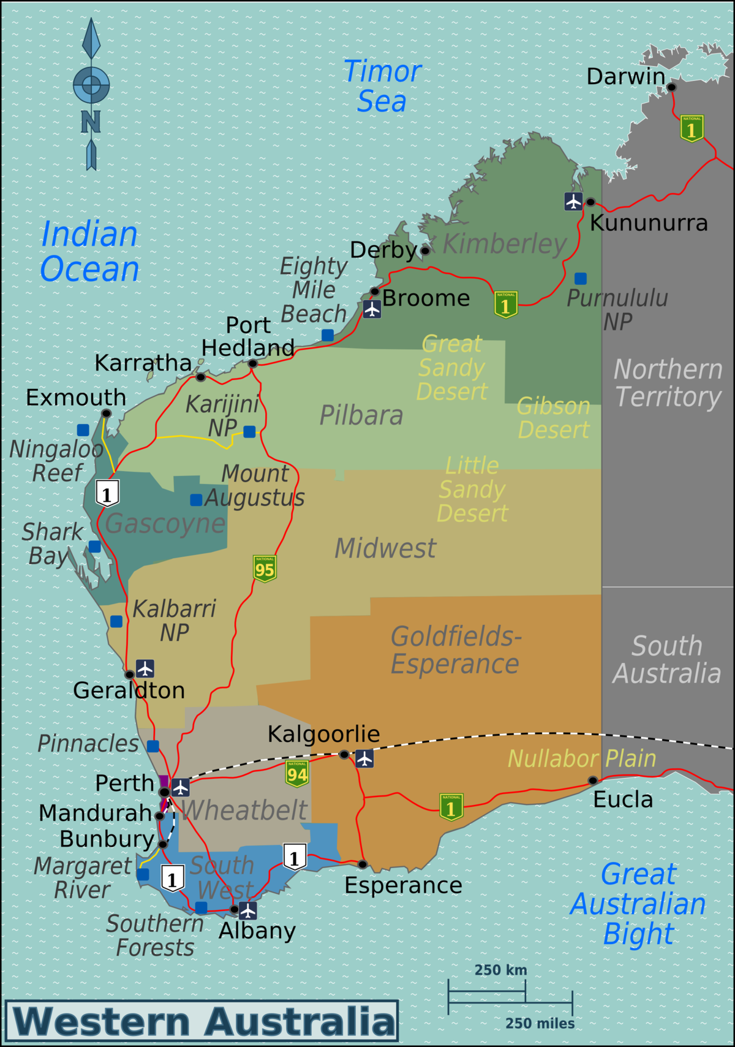
MAP – Wheatbelt and SW of WA,

Slide 4
Facts - Australia Southwest of W.A. and Wheatbelt
Location – Southwest of Western Australia (38,564 sq km); Wheatbelt – (154,862 sq km)
Population –SW of W.A – 365,303 and Wheatbelt 137, 175
Population density (per sq km) – 9.47 persons per sq km (SW of W.A) and 0.38 persons per sq km (Central Wheatbelt)
Nearest Capital City – Perth
% living in urban areas – 92% of WA residents live in the southwest region.
Geography – SW of W.A - coastlines, plains, plateaus, beaches, tall forests.

Slide 5
Land degradation from land clearance and management in SW of W.A and the Wheatbelt.
PLACE: SITUATION
SW of W.A.
More than 23,000 km make up the south west corner of W.A.
South west of Perth Metropolitan Area.
Wheatbelt –
Partially surrounding the Perth metropolitan area, extending north from Perth to the Mid-West region and east to the Goldfields-Esperance region. Bordered to the south by the Southwest and Great Southern regions, and the west by the Indian Ocean.
.

Slide 6
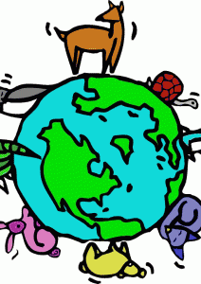
Land clearance in SW of W.A and Wheatbelt
ENVIRONMENT:
Previously a diverse ecosystem – reduced when clearing started in 1890’s. Wheatbelt – home to around 11% of Australia’s critically endangered plants. Threatened bird species, such as Carnaby’s Black Cockatoo have habitats here.

Slide 7
Land clearance in SW of W.A and Wheatbelt
(Environment)
Site Features of SW of W.A and Wheatbelt
Site: Climate – Mediterranean – hot, dry summers and mild wet winters.
South West of W.A:
Bordered by the Indian and Southern oceans
Broad coastal plain 20-120 kilometres wide.
Forests, woodlands and scrub.
Wheatbelt:
Very flat and ancient river valleys filled with sediment.
Salt lakes

Slide 8
Land clearance and management in SW of W.A and Wheatbelt
SPACE: Size of location
Southwest of Western Australia (38,564 sq km); Wheatbelt – (154,862 sq km)

Slide 9

SCALE:
Scale of Change over time (temporal distribution) – More than half of all land developed for agriculture in the wheatbelt was cleared between 1945 and 1982. (Bradshaw, 2012)
* WA has one of the worst deforestation rates in the world (global scale), and the wheatbelt of WA is one of the most degraded areas in Australia.

Slide 10
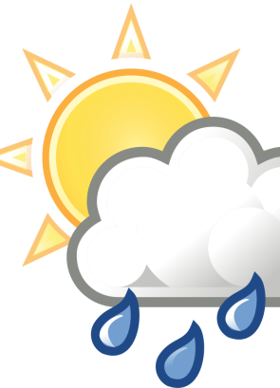
Land clearance in SW of W.A and Wheatbelt
INTERCONNECTION:
Area of food production
People have an interconnection to the forests and coastlines etc
Forests help to reduce soil erosion
Close-knit rural communities (people)
Tourism locations

Slide 11
Land clearance in SW of W.A and Wheatbelt
CAUSES OF DEFORESTATION/LAND CLEARANCE:
Clearing the land for:
Logging – WA government - Phased out logging in all native forests by 2033. Stop logging in SW by 2024.
Infrastructure – road network
Tourism – south west of WA
Mining – coal (Collie), bauxite (Boddington), gold (Boddington)
Population growth (e.g. building infrastructure and settlements) e.g. Vasse
Intensive and Extensive agriculture – e.g. viticulture (grapes), Mixed Crop Livestock, Extensive cropping in Wheatbelt.

Slide 12
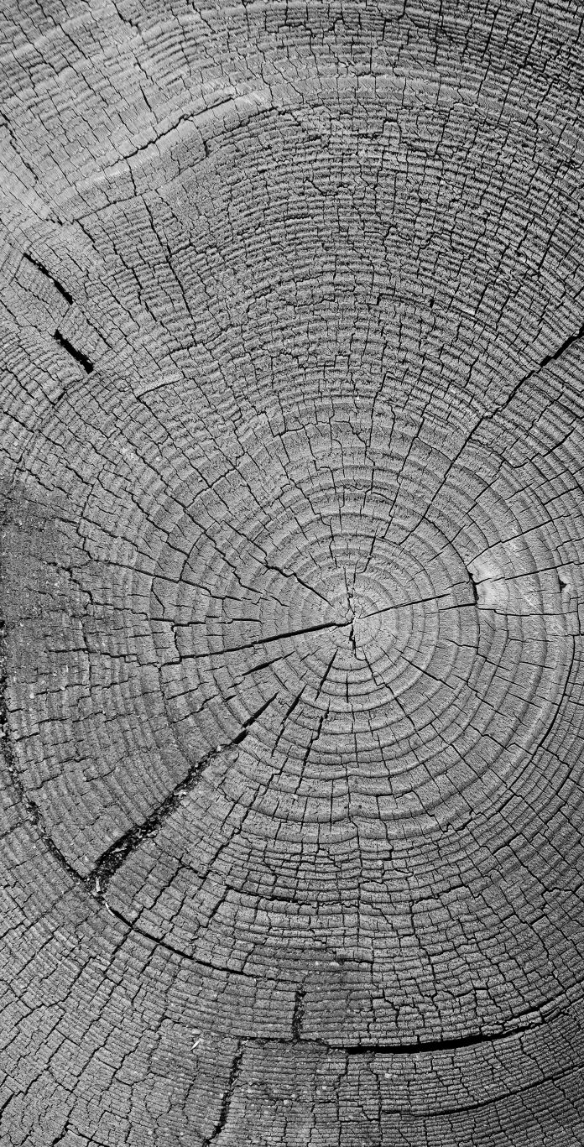
Land clearance in SW of W.A and Wheatbelt
LIKELY CONSEQUENCES
(IMPACTS/EFFECTS) OF DEFORESTATION:
Climate change
Loss of biodiversity – e.g. Carnaby’s Black Cockatoo
Changes to water cycle
Woodlands in the wheatbelt are fragmented (scattered remnant vegetation)
Habitat loss and fragmentation
Reduces the water cycling services provided by trees.
Land degradation – deforestation has led to soil erosion, reduced soil fertility, dryland salinity, soil compaction

